Slide 1
IoT Smart Home Application
Abdullah Keskin 20180808049 (UG)
Barış Baran Çiçek 20180808018 (UG)
Hamza Bora Kocaoğlu 20180808006 (UG)
Project GitHub Repository
https://github.com/Bar1237/IoT-Smart-Home-Application

Slide 2
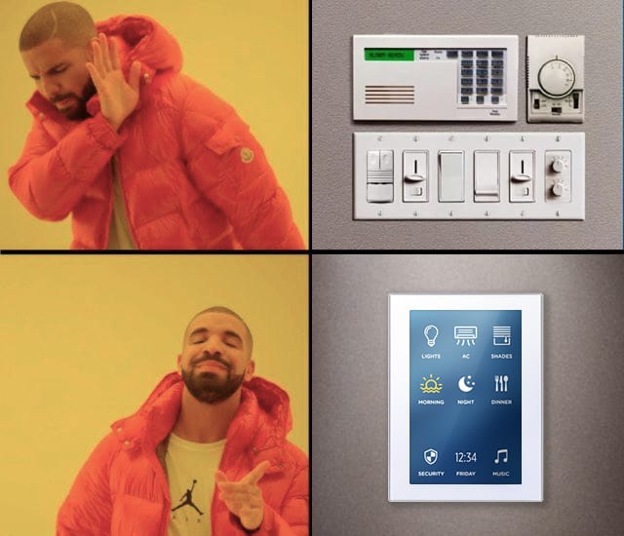
What and Why?
Saves time
Makes life easier
Security
Energy saving

Slide 3
Table Of Content
Project Details
Tools / Technologies
Status of Deliverables
Problems That We Faced
How the System Works
Code Review
Demo

Slide 4
Project Details
Smart home automation system
Raspberry Pi and relays
Door unlocking
Multiple device support.

Slide 5







Tools / Technologies
Technologies
Flask
Socket.io
OpenCV
Tools
Vs Code
GitHub
PyCharm IDE

Slide 6
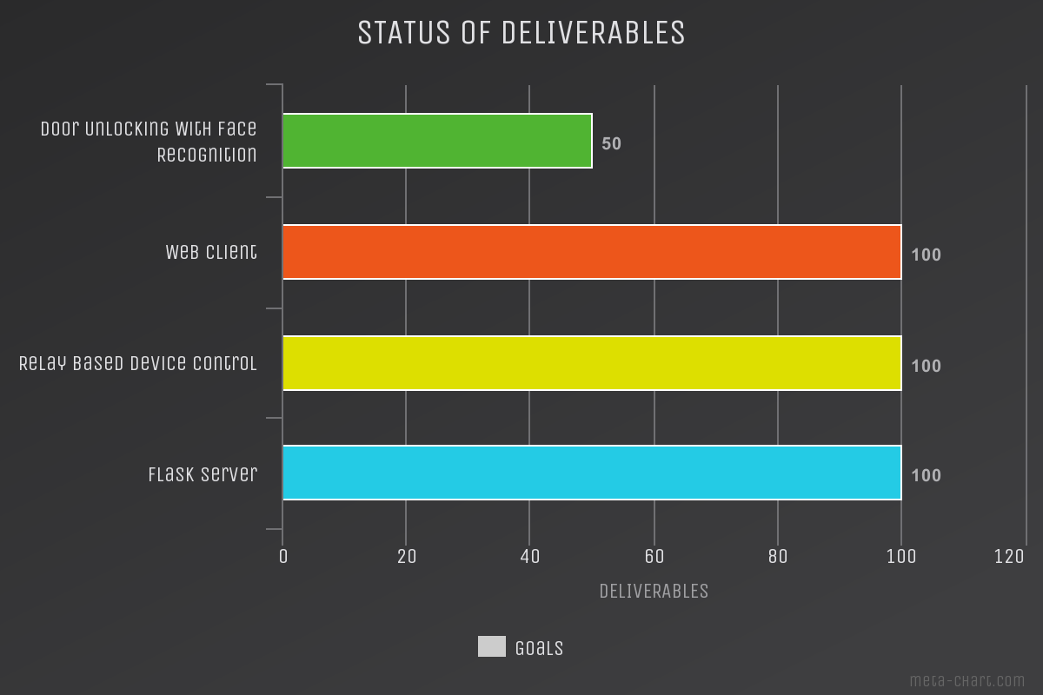
Status of Deliverables

Slide 7
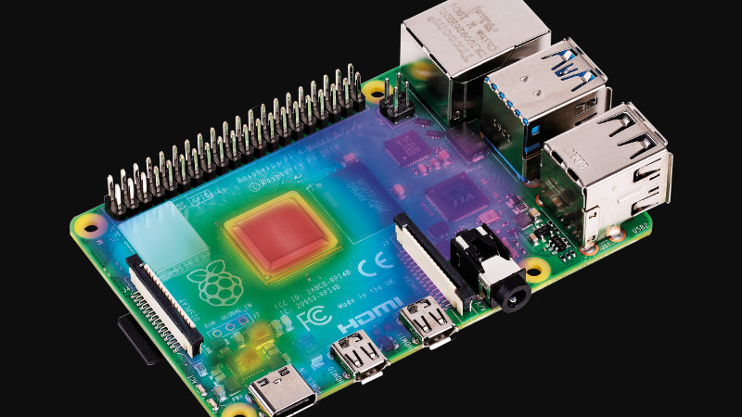
Problems That We Faced During Development
Over-Heating Problems : Separating server from Raspberry solved this problem.

Slide 8
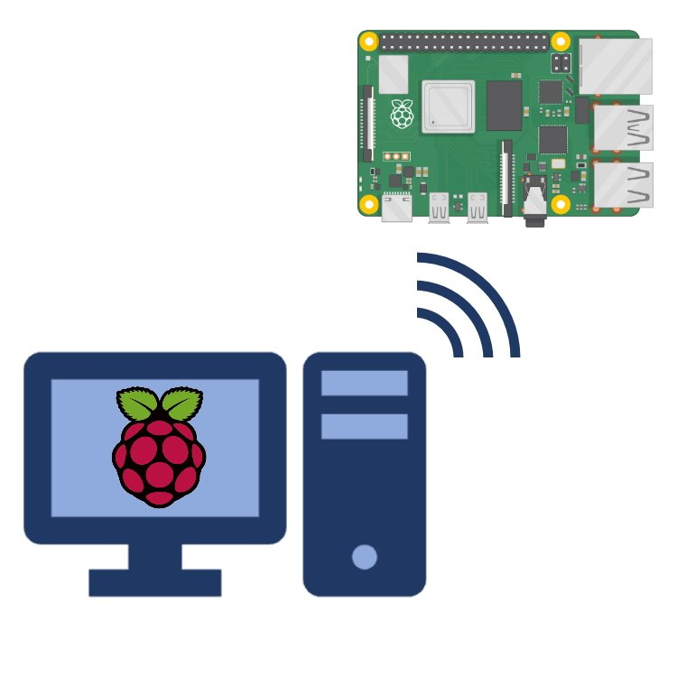
Problems That We Faced During Development
Remote Access to Raspberries : Using XRDP and Putty to remote access was the solution to this.

Slide 9
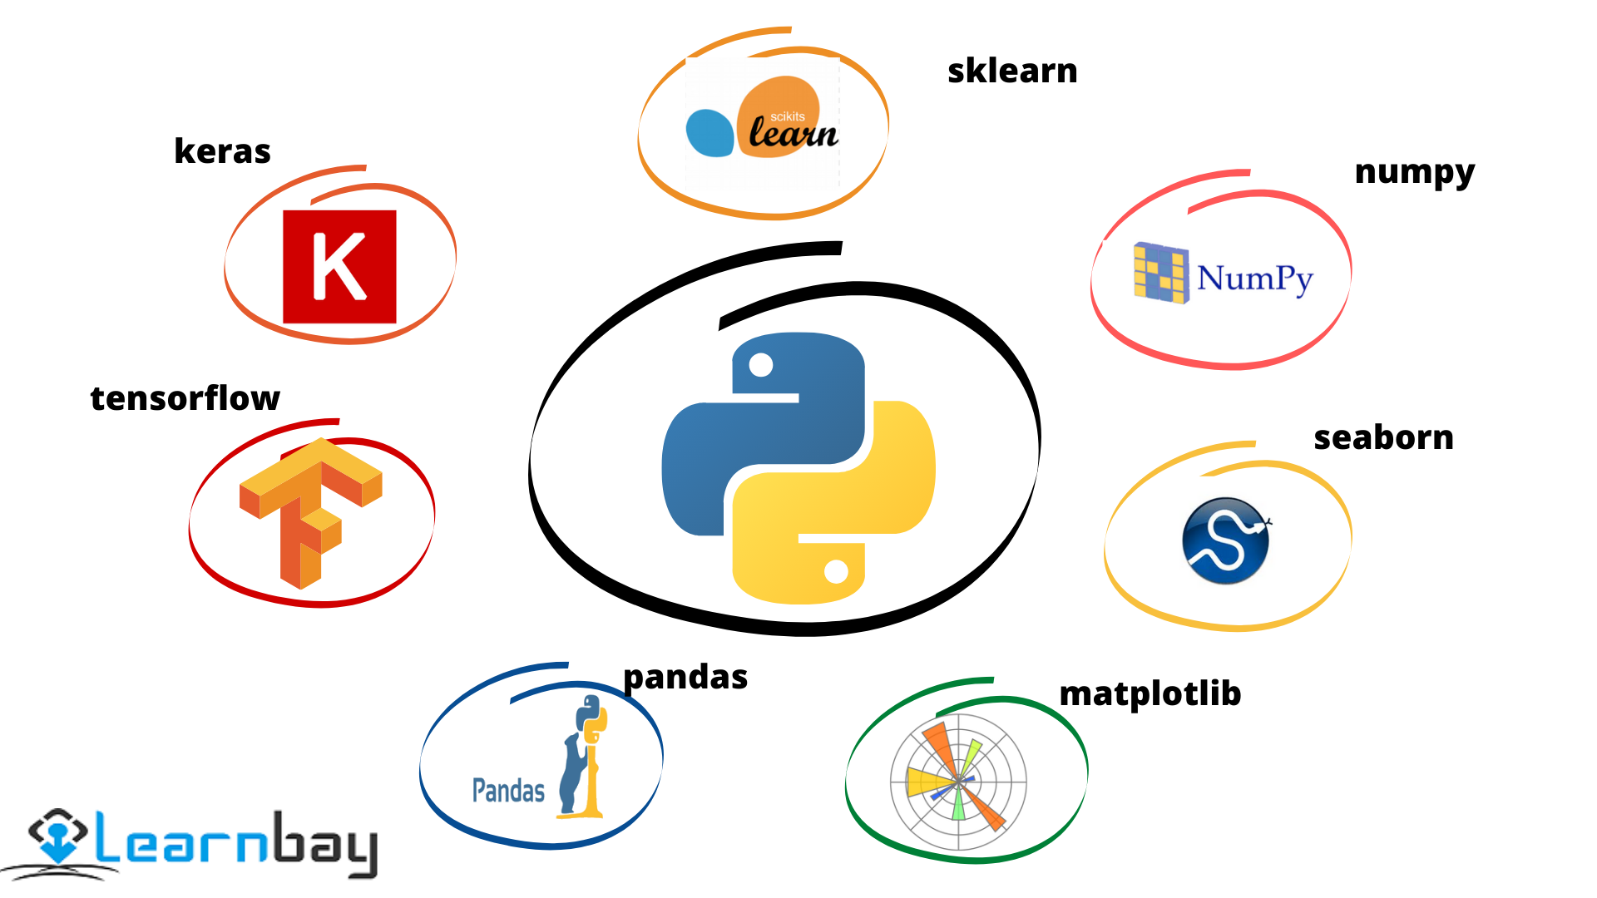
Problems That We Faced During Development
Library compatibility : Not using Windows at this kind of projects was solution.

Slide 10

Problems That We Faced During Development
Port Restriction : Port 5000 is blocked on Windows by default.

Slide 11
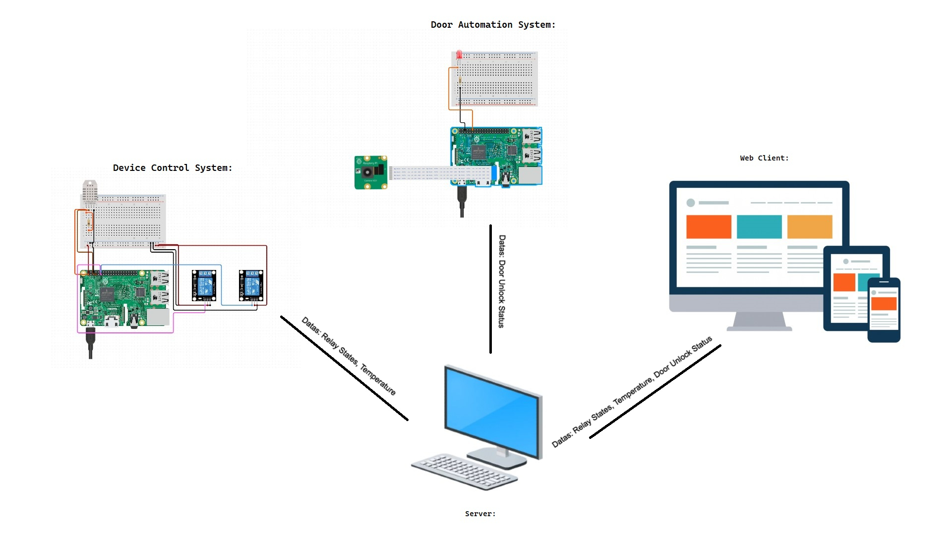
How System Works
Notes:
Abdullah Server and Device control System
Barış Web Client
Hamza Door automation

Slide 12
Code Review

Slide 13
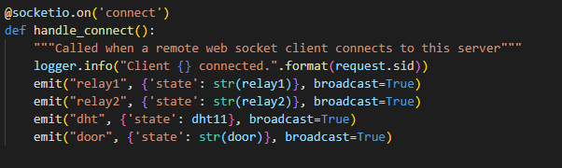
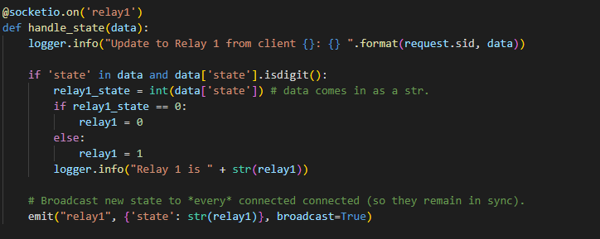
Code Review / Server Side
Flask Server Client Connection
Flask Server Relay Controls

Slide 14
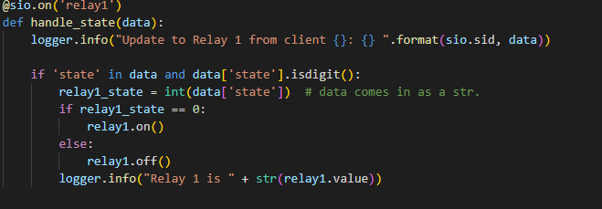
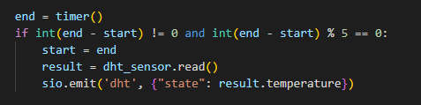
Code Review / Client Side
Socket-IO Client relay controls
Socket-IO Client sending data to server

Slide 15
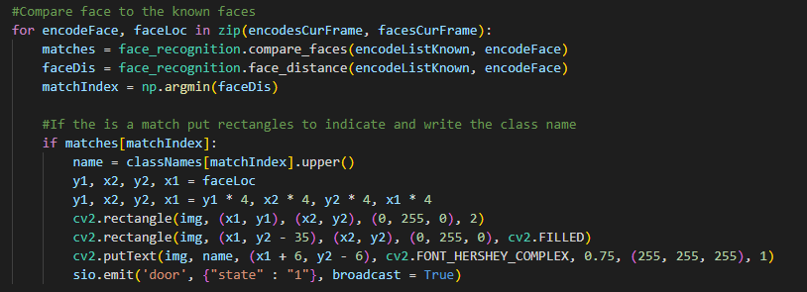
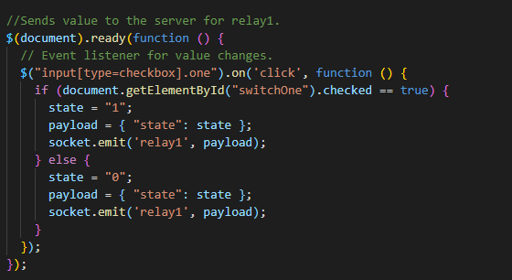
Code Review / Web Client & Face Recognition
Face Recognition based door unlocking
Web Client sending data to server

Slide 16
Demo

Slide 17
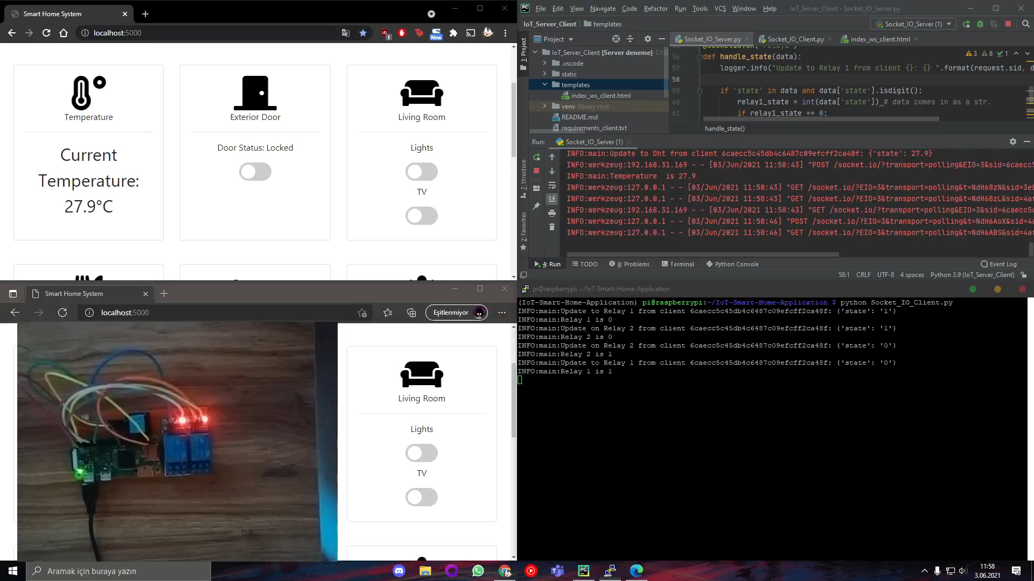

Slide 18


